Slide 1
Music Moderation
Automatic Music Transcription (AMT)
Date:21-01-2022

Slide 2
Problem statement
Have you ever made a recording of yourself improvising at the piano and later wanted to know exactly what you played?
Automatic Music Transcription (AMT) is a fundamental problem in Music Information Retrieval (MIR).
The challenge is to translate an audio sequence to a symbolic representation of music.
Furthermore, we can extend this to incorporate anomaly detection by comparing the output symbolic representation against a master piece to give feedback to the user on how to improve.

Slide 3
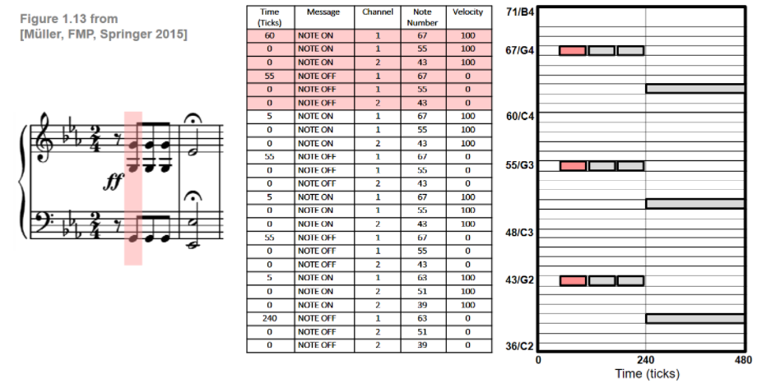
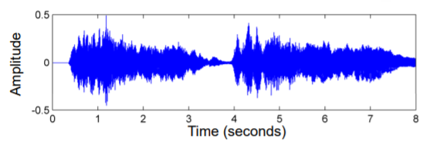
Music Representations
Symbolic representations – MIDI and Piano Roll.
description based on entities with explicit musical meaning.
given in digital format that can be parsed by a computer.
Sheet music representation
visual description of a musical score.
image format (printed or scanned).
Audio representation
physical description
encoding of sound wave
Pianoroll is a music storing format which represents a music piece by a score-like matrix. The vertical and horizontal axes represent note pitch and time, respectively. The values represent the velocities of the notes.
The above figure shows various symbolic music representations of the first twelve notes of Beethoven's Fifth including a sheet music representation, a MIDI representation (in a simplified, tabular form), and a piano-roll representation.

Slide 4
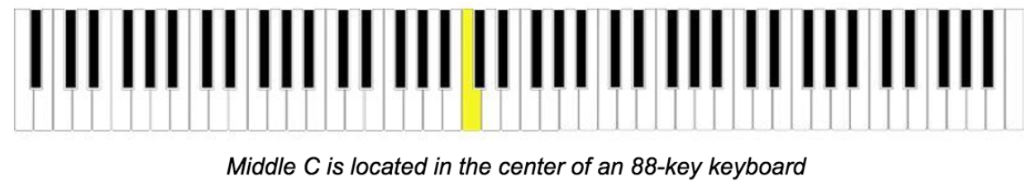
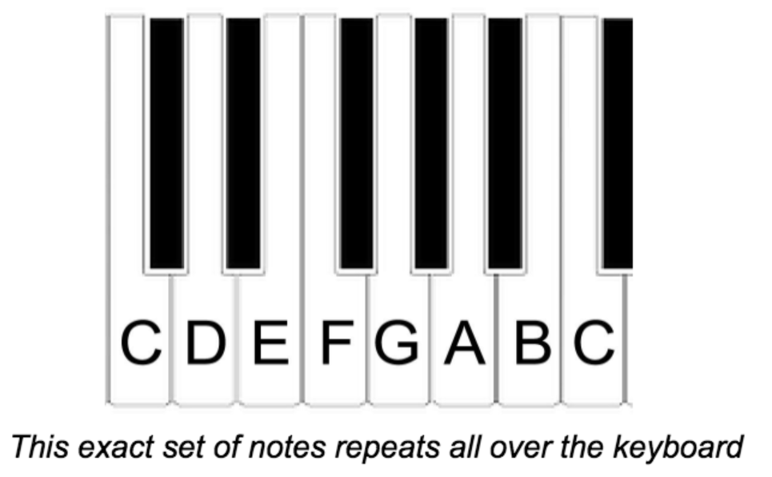
Piano - Introduction
Many traditional pianos have 88-key keyboards, but you’ll stick to playing just one octave (an octave is a set of eight white keys). The first thing we’ll show you is where middle C is located on the keyboard. From this spot, you’ll learn every note name on the piano:
The piano’s keyboard is built off of repeating sets of white and black keys.
Starting from middle C, the white keys follow the alphabet note-by-note until they reach G where they’ll reset to an A on the next note.

Slide 5
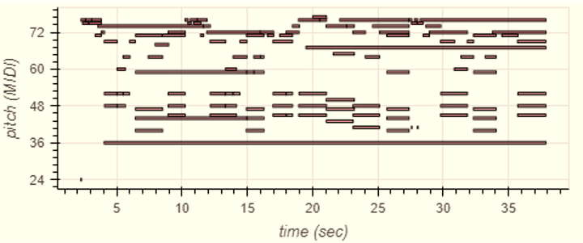
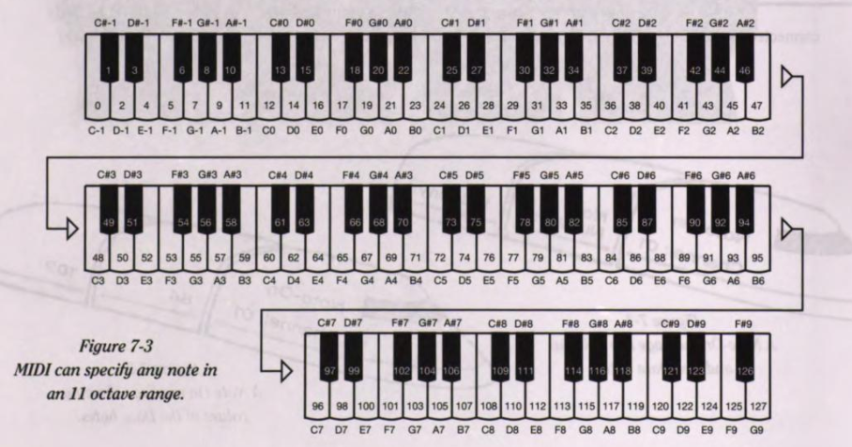
Terminologies
Midi Note/Pitch of a note :
The MIDI note number is an integer between 0 and 127 that encodes the note's pitch.
Musical notes or tones have a pitch. The pitch of a particular note is often given as a number.
Most importantly, C4 (middle C) has MIDI note number 60, and A4 (concert A440) has MIDI note number 69. MIDI note numbers separated by 12 are separated by one octave, e.g. 72 = C5, 84 = C6, etc.
This is more than sufficient since a
Standard piano-style keyboard has
No more than 88 keys.

Slide 6
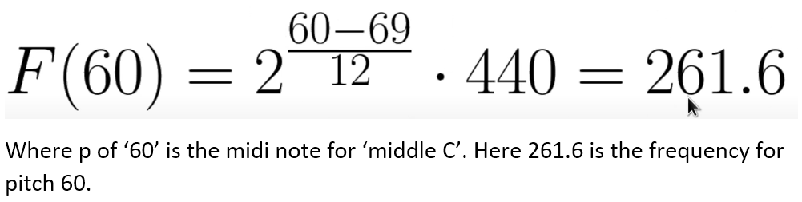
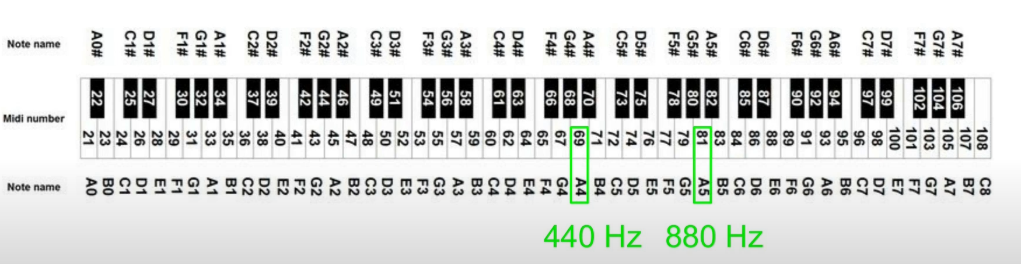
Frequency :
The technical term for pitch is frequency.
If you pluck a violin string tuned to Middle A, the string will vibrate or oscillate back and forth and will have a certain pitch.
For example, the note "A" in the middle of a piano is designated A=440. Now, the question is 440 what?
This number is how many oscillations occur in 1 second.
*1 Hertz corresponds to 1 oscillation/second

Slide 7
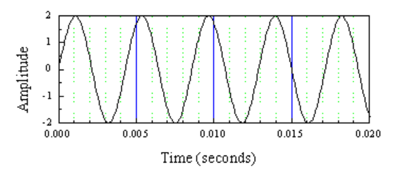
Period/Interval :
So, the time it takes for 1 oscillation is called the period, and the period is related to the frequency by:
Period = 1/frequency
For the example of a pitch of 440 Hz, the period will be:
1/(440/sec) = (1/440) sec = 0.00227 sec
= 2.27 millisecond
= 2.27 msec.
Amplitude:
Besides the pitch of a musical note, perhaps the most noticeable feature in how loud the note is. The loudness of a sound wave is determined from its amplitude.
Note-on (onset) and Note-off (offset):
The most important MIDI messages are the note-on and the note-off commands, which correspond to the start and the end of a note, respectively.
Key velocity:
The key velocity is again an integer between 0 and 127, which controls the intensity of the sound. —in the case of a note-on event it determines the volume, whereas in the case of a note-off event it controls the decay during the release phase of the tone.
Timbre:
One more attribute to sound waves that you are familiar with, and that is tone quality. This is what makes different instruments sound different.

Slide 8
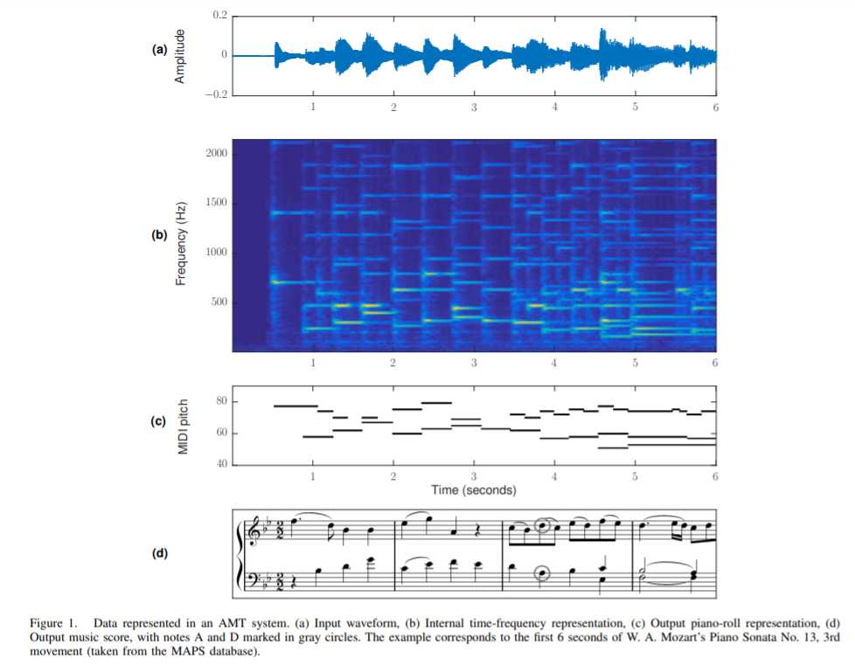
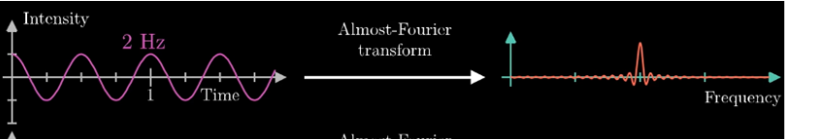
AMT Overview
At a high level, an AMT system has:
Input : It takes an audio waveform as input (Fig. 1a) .
Processing: Convert Time domain (wave form) into the Frequency domain :
using transformation such as ‘Fourier transform or CQT (constant-Q transform) or mel-scaled spectrograms.
Libraries that can be utilized are librosa or tf.signal library (still exploring this part).
Deep learning Model:
The spectrogram can be converted to
an array and fed to a Neural network model.
An Encoder-decoder transformer model can be used where we train a model to encode raw spectrogram frames and decode directly to a sequence of note events inspired by messages in the original MIDI protocol.
Output #1 : A representation of pitches over time (also called a piano-roll representation, Fig. 1c)
OUTPUT #2 : or a typeset music score (Fig. 1d).

Slide 9
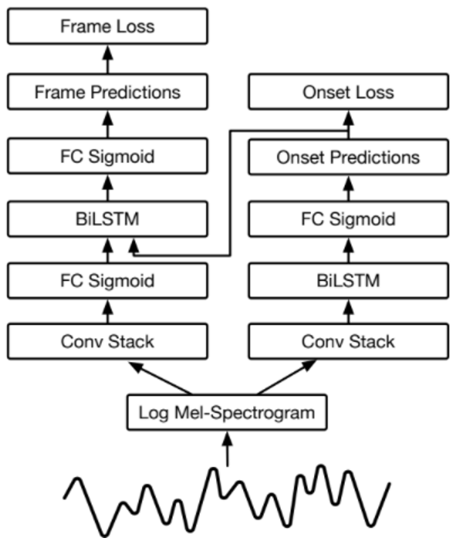
AMT Approach 1:
Using two networks:
This approach combines two networks (Fig. 6): one network is used to detect note onsets and its output is used to inform a second network, which focuses on detecting note lengths.
The onset detector is composed of the acoustic model, followed by a bidirectional LSTM [17] with 128 units in both the forward and backward directions, followed by a fully connected sigmoid layer with 88 outputs for representing the probability of an onset for each of the 88 piano keys.
The frame activation detector is composed of a separate acoustic model, followed by a fully connected sigmoid layer with 88 outputs. Its output is concatenated together with the output of the onset detector and followed by a bidirectional LSTM with 128 units in both the forward and backward directions. Finally, the output of that LSTM is followed by a fully connected sigmoid layer with 88 outputs.
Source:
https://arxiv.org/pdf/1710.11153.pdf

Slide 10
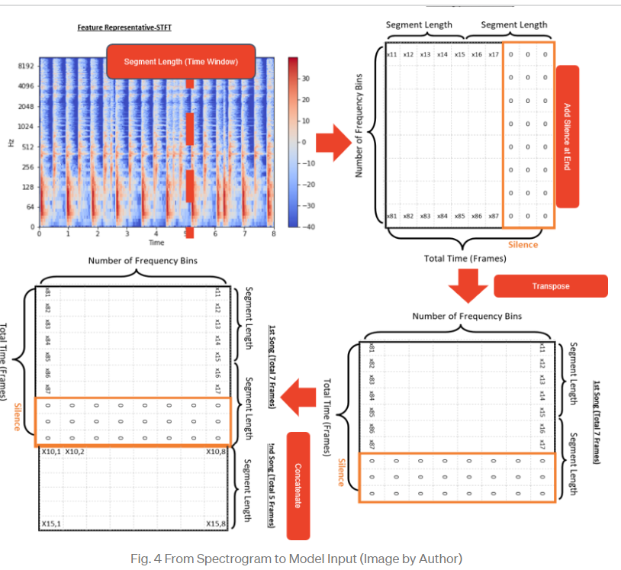
AMT Approach 2:
Bidirectional Long Short-Term Memory (BILSTM) neural network
Step 1: Transfer Audio to STFT spectrogram using Librosa and segment length which is the fixed time window of input feeding into the RNN model is selected.
Step 2: Transfer Spectrogram to Array: each row in the array represents the frequency level and the column is the time frame. The value in the array represents the amplitude.
Step 3: Each song would have the same number of frequency levels but not the same total time.
Therefore, the array is transposed so that each song would have the same number of columns.
Step 4: With this array shape, spectrograms of songs available in the open database are easily concatenated together and fed into the model.
Source:
https://towardsdatascience.com/practical-introduction-to-automation-music-transcription-3ad8ad40eab6

Slide 11
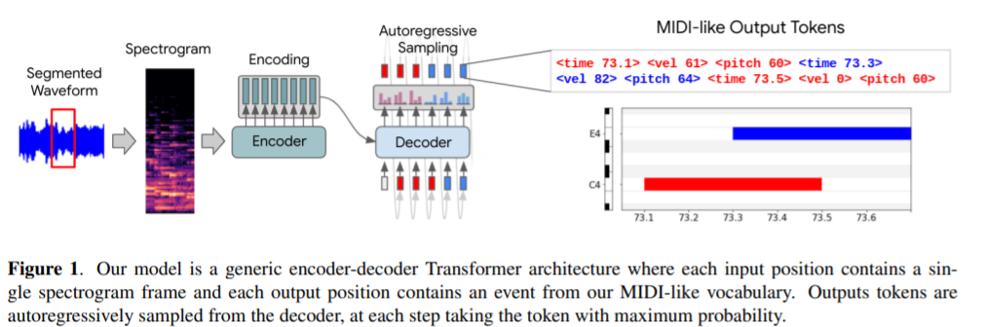
AMT Approach 3:
Source:
https://archives.ismir.net/ismir2021/paper/000030.pdf
Using T5X transformer.
At its core, music transcription can be posed as a sequence-to-sequence task, where the input is a sequence of audio frames, and the output is a sequence of symbolic tokens representing the notes being played.
Model is a generic encoder-decoder Transformer architecture where each input position contains a single spectrogram frame and each output position contains an event from our MIDI-like vocabulary.
Idea is to encode raw spectrogram frame to 512 positions (511 spectrogram frames plus a learnable EOS embedding) and decode into 1024 positions (1023 symbolic tokens plus a learnable EOS embedding).
As with any transformer modes (heavily used in NLP), Piano transcription model uses its own vocabulary with token types of “Note”,” Velocity”,” Time”,” EOS”.
Inputs are processed through a stack of encoder self-attention layers resulting in a sequence of embeddings the same length as the original input.
A stack of decoder layers then uses both causally masked self-attention over the decoder output and cross-attention over the full output of the encoder stack.

Slide 12
DataSets
“Lakh MIDI Dataset” (LMD)
Using the previously described sequence to sequence approach, given a database of sequences, https://colinraffel.com/publications/thesis.pdf paper focuses on a fundamental task is to find the database entry which is the most similar to a query.
More specifically, focus is to match MIDI files (a digital score format) to a large collection of audio recordings of music.
After developing these approaches, we applied them together to the practical task of matching 178,561 unique MIDI files to the Million Song Dataset.
The resulting “Lakh MIDI Dataset” provides a potential bounty of ground truth information for audio content-based music information retrieval. This can include transcription, meter, lyrics, and high-level musicological features
Lakh Pianoroll Dataset (LPD)
The Lakh Pianoroll Dataset (LPD) is a collection of 174,154 multitrack pianorolls derived from the Lakh MIDI Dataset (LMD).
LPD-matched
lpd-matched contains 115,160 multitrack pianorolls derived from the matched version of LMD.
MAESTRO (MIDI and Audio Edited for Synchronous TRacks and Organization) is a dataset composed of about 200 hours of virtuosic piano performances captured with fine alignment (~3 ms) between note labels and audio waveforms.
The MAESTRO Dataset

Slide 13
Challenges
Many music datasets are relatively small in comparison to the datasets used to train large-scale sequence models in other domains such as NLP or ASR. Existing opensource music transcription datasets contain between one and a few hundred hours of audio, while standard ASR datasets LibriSpeech (Panayotov et al., 2015) and CommonVoice (Ardila et al., 2020) contain 1k and 9k+ hours of audio, respectively.
The annotation of ground-truth transcriptions for polyphonic music is very time consuming and requires high expertise. The lack of such annotations has limited the use of powerful supervised learning techniques to specific AMT sub-problems such as piano transcription, where the annotation can be automated due to certain piano models that can automatically capture performance data.
Polyphonic music contains a mixture of multiple simultaneous sources (e.g., instruments, vocals) with different
pitch, loudness and timbre (sound quality), with each source producing one or more musical voices. Inferring
musical attributes (e.g., pitch) from the mixture signal is an extremely under-determined problem.

